Slide 1
Penetration Testing and Social Engineering

Slide 2
Lesson Overview
Purpose
Information Gathering
External Access
Physical Access

Slide 3
Penetration Testing
What are the vulnerabilities?
Notes:
NIST 800-115
https://nvlpubs.nist.gov/nistpubs/Legacy/SP/nistspecialpublication800-115.pdf
5.3 - Social Engineering - Phishing

Slide 4

Scope Matters
What is allowed?

Slide 5



Information Gathering
Notes:
Elise
Transformers
Neal

Slide 6


External Access
Malware
Credentials

Slide 7

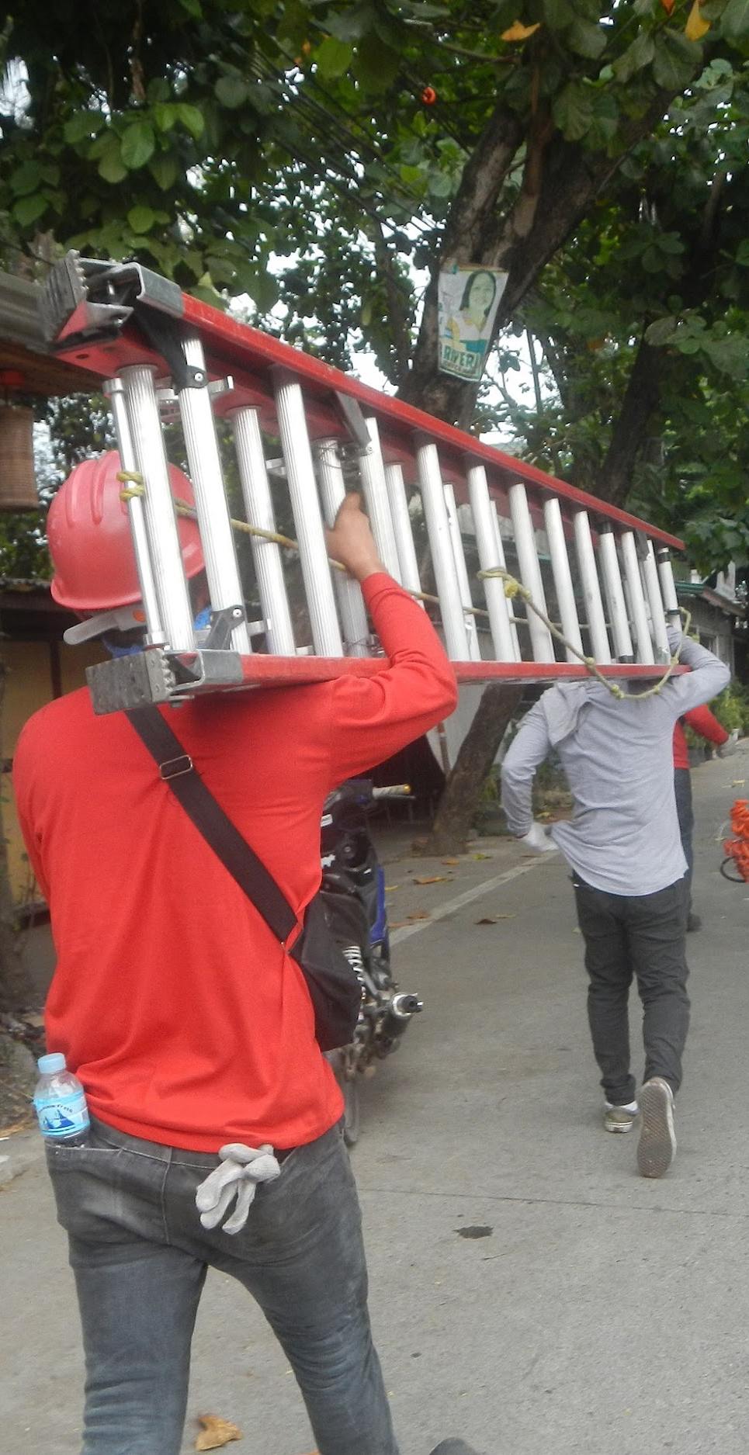

Physical Access

